Slide 1
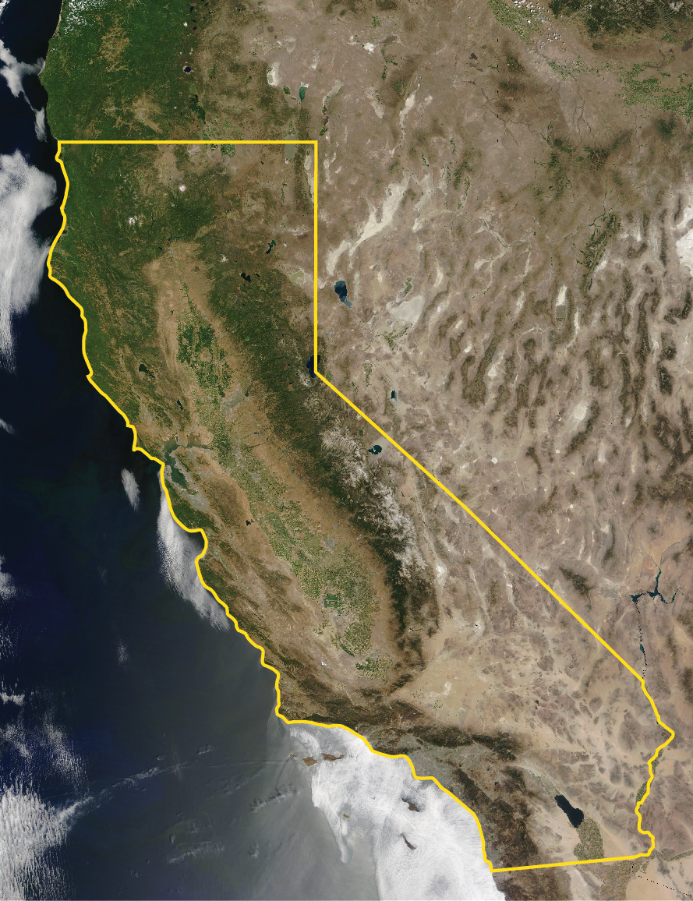
Imperial Irrigation District May 2, 2023 Tina Shields, PE Water Department Manager

Slide 2
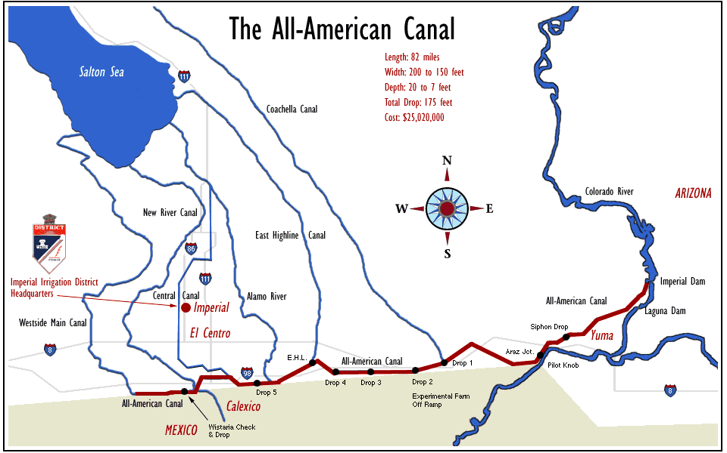
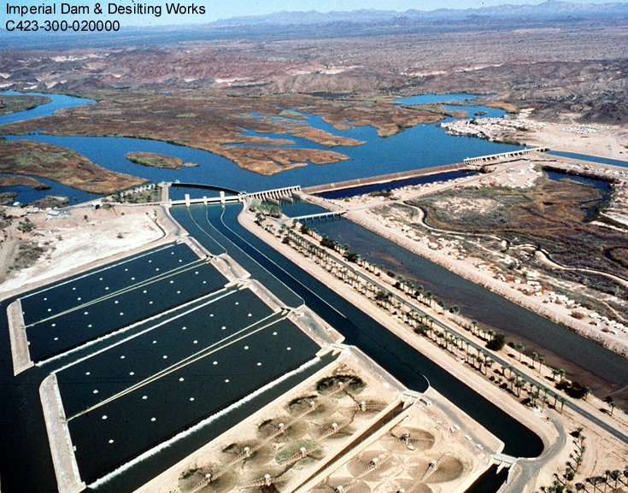
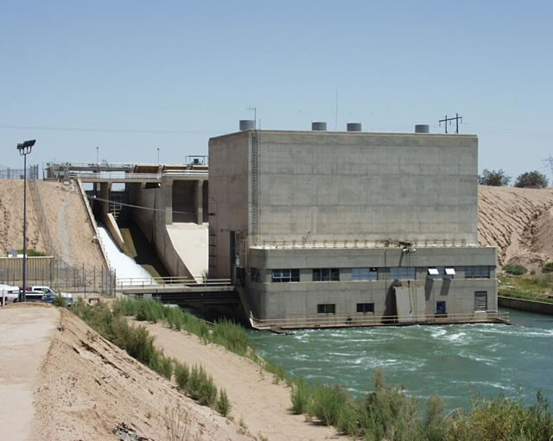
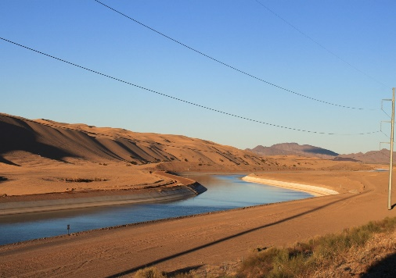
IID’s Water Supply & Service Area
3,100,000 acre-feet annual Colorado River consumptive use entitlement
1,062,216 – gross acres within
boundaries
520,307 – total acreage receiving
water
471,570 – total farmable acreage
Imperial Dam diversion structure,
headworks and six desilting basins
82-mile long All-American Canal
> 3,000 miles gravity flow canals/drains
Nine hydroelectric
plants
Notes:
IID is the largest irrigation district in the nation, diverting Colorado River water through Imperial Dam and its six desilting basins to deliver supplies to both the Yuma region and Mexico. The water then travels through the All-American Canal to the tribes and Coachella Valley Water District, generating hydro power along the way, and eventually making its way to IID’s service area over 80 miles west. IID manages a 3.1 MAF annual entitlement, capped during the term of the QSA, including 2.6 million acre-feet of present perfected water rights that are used to support our rural community and farms.

Slide 3
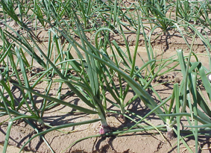
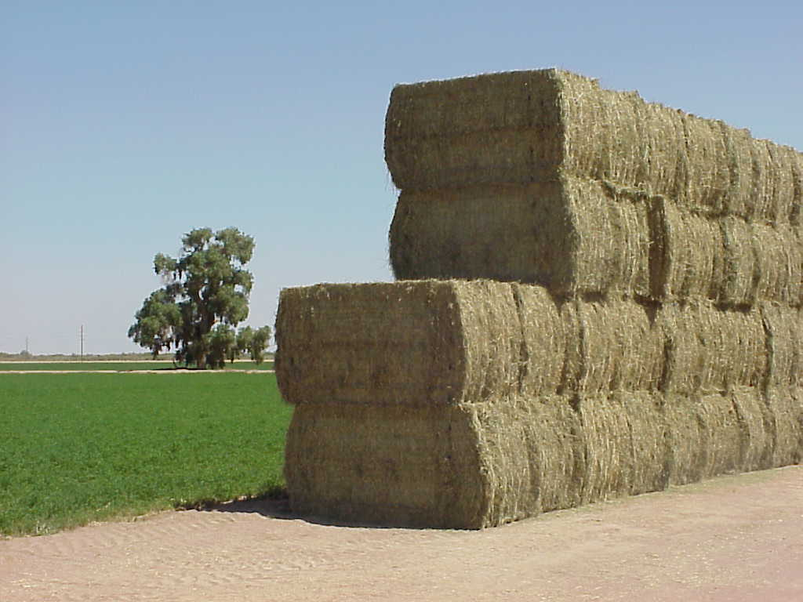
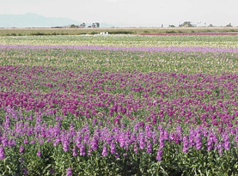
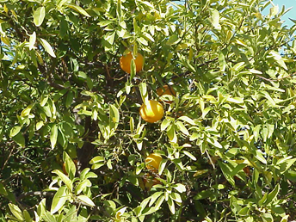
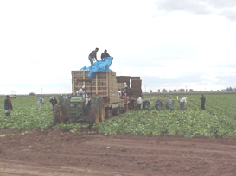
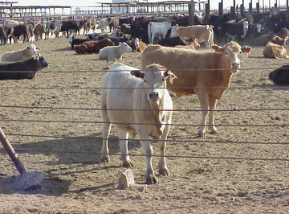
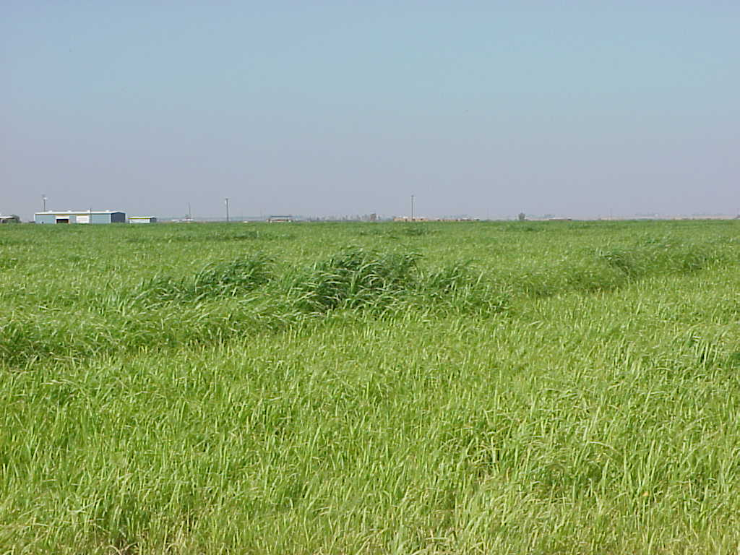
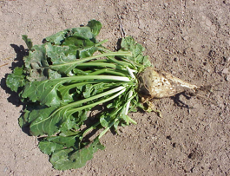
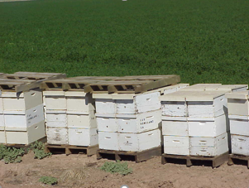
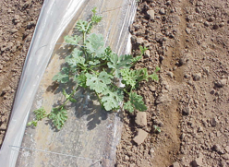
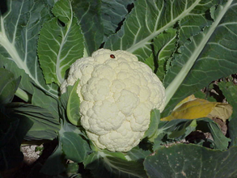
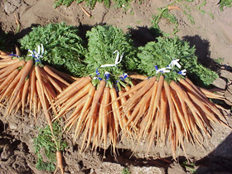
Imperial Valley’s Agricultural Economy
Notes:
With a year-round growing season, IID farmers are responsible for producing the vegetable and forage crops that provide this state and nation with a safe, reliable food supply. Over ½ million acres of prime agricultural land are served by IID. Imperial Valley farmers grow a wide variety of high yield produce and field crops that drive a local economy in which one in every six jobs is directly related to agriculture. If you eat beef, cheese, pasta, salad or stir-fry, or enjoy a cold glass of milk or a squeeze of citrus in your beer or cocktail, then you can not only thank a farmer, but thank an IID farmer, the farmworkers that support them and the local farm service providers that make it possible.

Slide 4
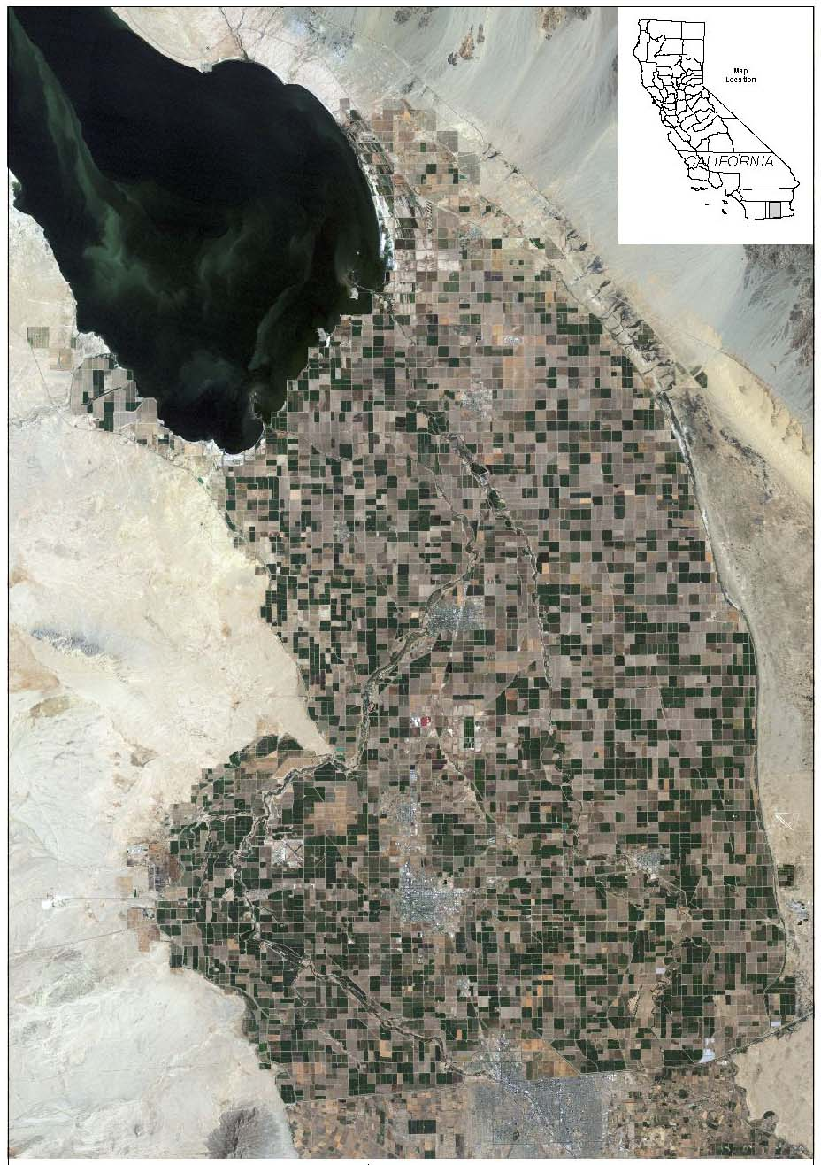
The Colorado River – A Critical Community Resource
The Colorado River is the region’s only water supply, with water delivered to rural farms, communities, homes and businesses.
IID has a year-round growing season with robust cropping yields that provide the nation a safe and reliable food supply. One in every six jobs in Imperial Valley is directly related to agriculture.
The communities that rely on IID for water are largely disadvantaged, underserved minority populations.
IID conserves and transfers 16 percent of its water supply, more than 485,000 AFY, to other Southern California water districts to support regional water supply reliability.
The California Plan proposes for IID’s conservation to increase to about 750,000 AFY, or more than 24 percent of IID’s entitlement.
Any IID conservation reduces Salton Sea inflows, contributing to ecosystem and public health (air quality) impacts.
Notes:
There are many unique aspects to the Imperial Valley, including the blazing hot summers and large-scale agricultural landscape. But foremost, after our diverse but tight-knit community, is the over 3,000 miles of open channel, gravity flow canals and drains built by our forefathers more than 110 years ago that make this satellite map so green. This conveyance system allows the precious Colorado River to flow to and through our service area; this River is Imperial Valley’s only source of water. We don’t have the luxury of a diversified water supply portfolio – there is no usable groundwater or other surface water supplies – and rainfall is insignificant.

Slide 5
The California Solution: QSA Water Conservation & Transfer Programs
2048-2077
Notes:
IID’s strategic plan identifies its primary mission, to provide reliable, efficient and affordably priced service, and it codifies the district’s goal to protect our community’s water rights for the sustained benefit of the regional economy, environment and the people we serve. However, since the late 1980’s IID’s water delivery business model has expanded to include a secondary function with the implementation of large-scale water efficiency improvement projects and programs. In his earlier comments, Mr. Harris mentioned the nation’s largest ag-to-urban water transfer, the Quantification Settlement Agreement, for which IID actively generates about a ½ million acre-feet per year of verified conservation yields through system improvements and on-farm efficiency conservation programs.

Slide 6
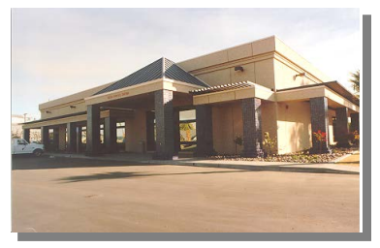
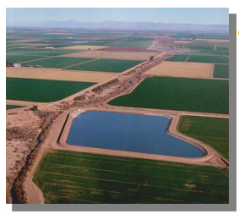
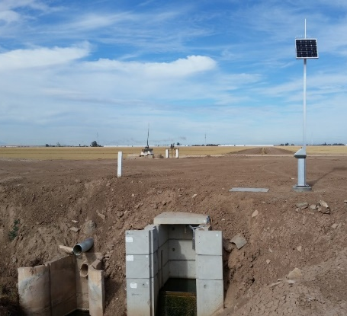
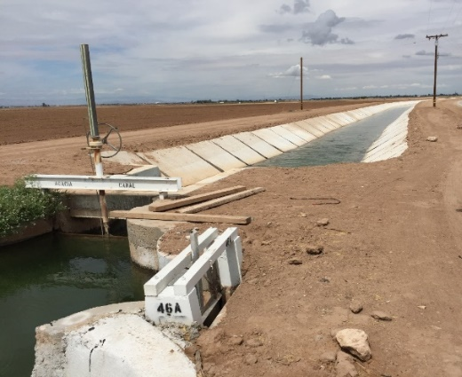
1988 IID/MWD Conservation Program
MWD funded capital improvements to IID’s conveyance system (completed in 1997) and related annual O&M expenses in exchange for the 105,000 acre-feet per year of conservation those projects generate.
Notes:
Beginning with its partnership with The Metropolitan Water District of Southern California, these collaborative efforts provide for California water supply reliability and support Colorado River resilience for a much larger region than Imperial Valley. The 1988 IID/MWD Conservation Program provided funding for IID to construct significant capital improvements to its conveyance system, and since its completion in 1997 this program supports the transfer of 105,000 acre-feet per year of conserved water to MWD. MWD has provided hundreds of millions of dollars in funding to IID to concrete line over 270 miles of canals, construct lateral interceptors and small operating reservoirs, and implement technology and automation supported by a new Water Control Center.

Slide 7
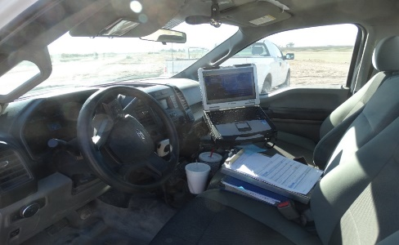
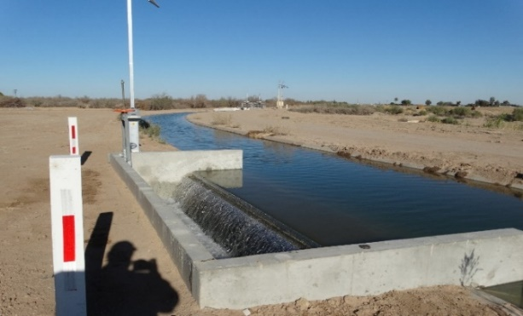
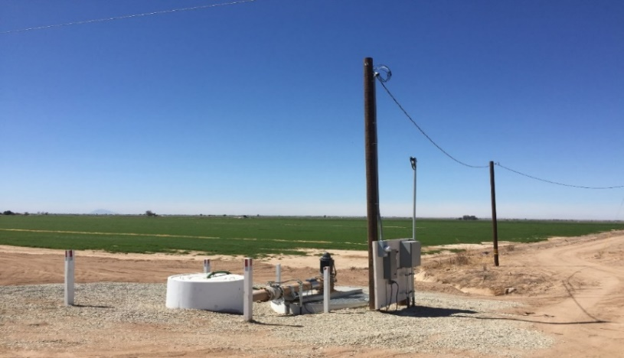
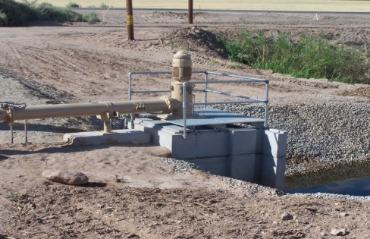
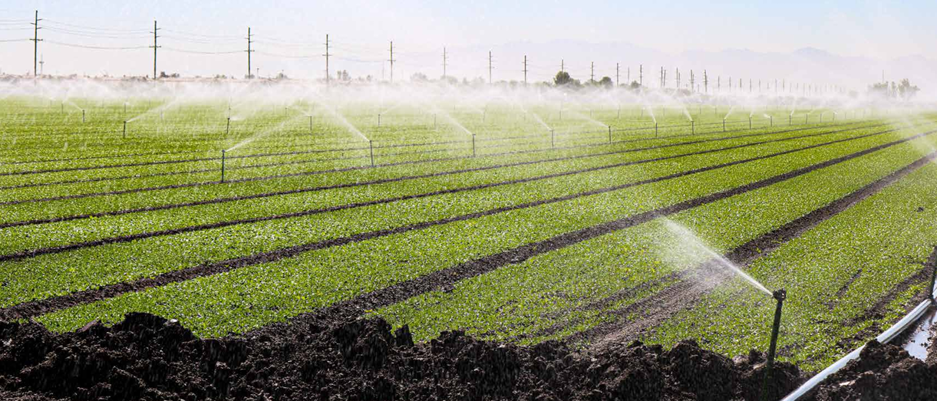
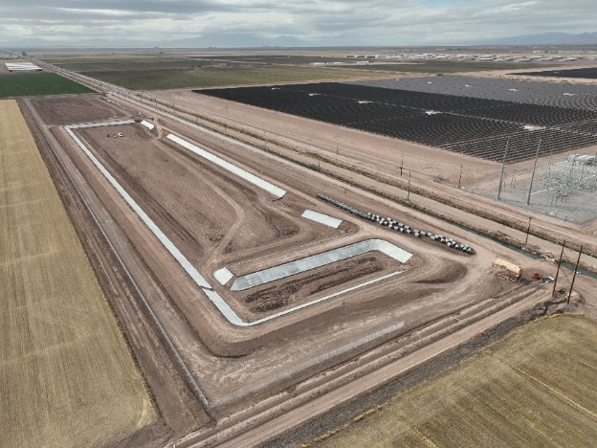
2003 QSA Conservation Programs
Construction of capital improvement infrastructure projects that conserve water and increase operational flexibility and implementation of on-farm efficiency conservation programs that provide funding for verified conservation measures to generate 200,000 AF for SDCWA and 103,000 AF for CVWD.
Seepage recovery systems, lateral interties, operational reservoirs, canal concrete lining, automation, and technology improvements.
$500+ million in direct payments to growers/landowners to implement field-level irrigation improvements (tailwater return systems, drip irrigation, sprinklers, precision land-leveling, etc.)
Notes:
A decade later, IID’s board of directors authorized a second conserved water transfer with the San Diego County Water Authority, which was bogged down in challenges and environmental complications at the Salton Sea that were ultimately resolved with the 2003 approval of the QSA. Since then, our partnerships with the Water Authority, and an additional transfer with CVWD, fund system improvements such as seepage recovery systems, lateral interties, mid-lateral reservoirs and more advanced technology and monitoring that generates 200,000 acre-feet per year for the Water Authority and 103,000 AFY for CVWD when that program’s ramp-up is complete 2026. More critically, these programs have also funded field-level conservation measures that allow our growers to implement irrigation improvements such as tailwater return systems, drip irrigation, sprinklers and precision land-leveling, all which improve their water use efficiencies to unparalleled levels while continuing to farm.

Slide 8
IID’s QSA Water Conservation & Transfer Summary (2003-2022 Total = 7,250,852 acre-feet)
Notes:
Since 2003, IID’s water management programs have generated over 7.25 million acre-feet of conserved water, from both on-farm and system efficiency programs, to meet these water transfer obligations and IID water storage objectives. And as I noted earlier, IID and its water users are currently conserving about ½ million acre-feet a year, or 16% of IID’s entitlement.

Slide 9
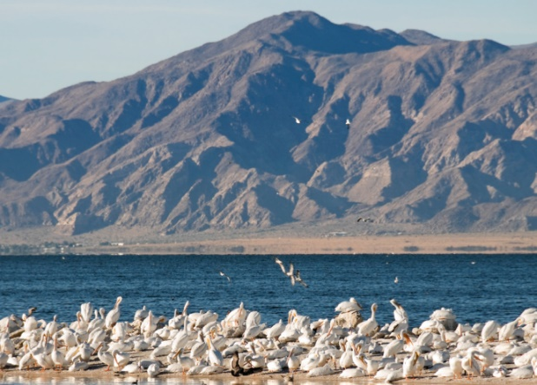
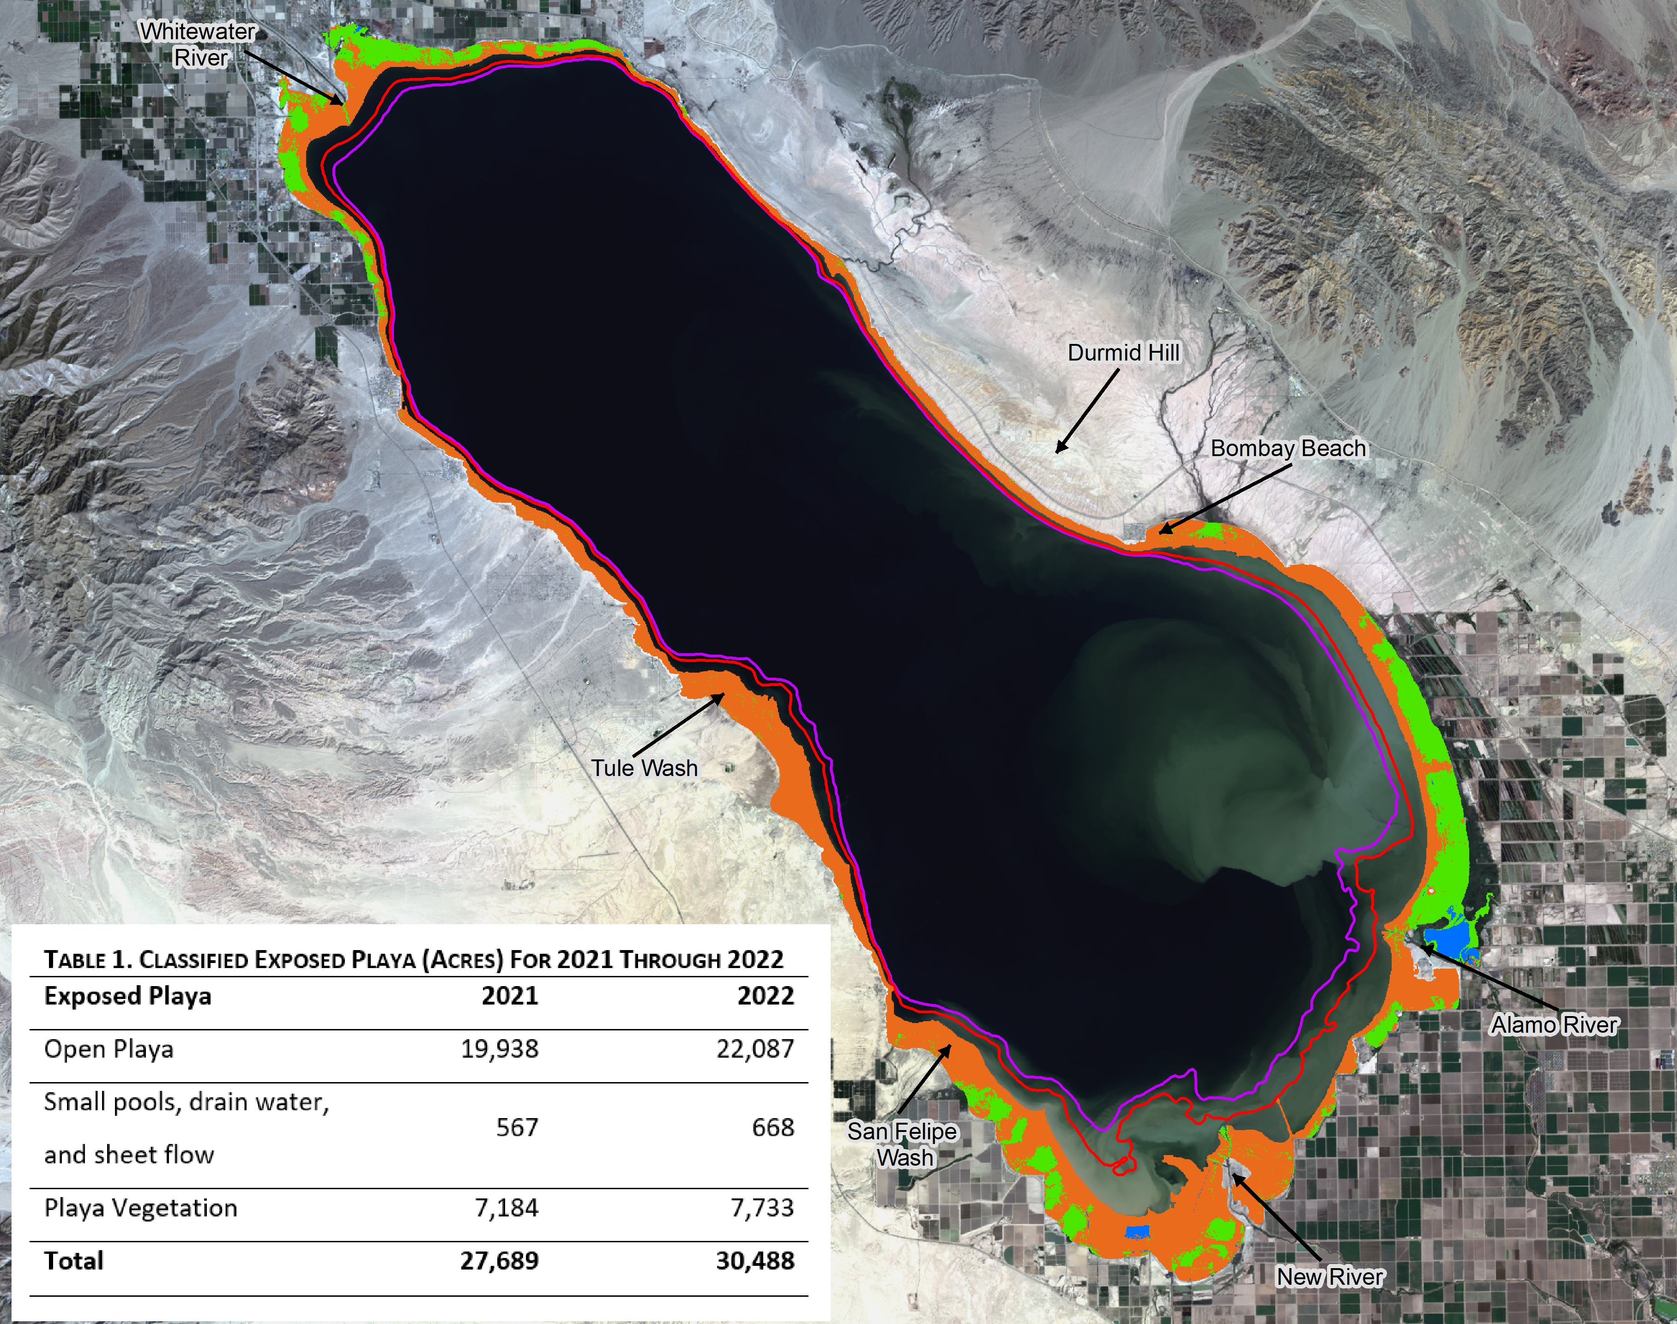
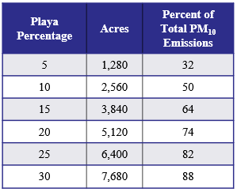
The Salton Sea
Highly saline endorheic lake
360 square miles, up to 52’ deep
Congressionally designated agricultural sump for IID/CVWD
Heavily used by migratory waterfowl including endangered species
≈ 11’ elevation decline since 2003; 30, 488 acres of playa exposed since 2003
Notes:
But these transfers do come at a cost to our region, and the Salton Sea is the poster child for consequential effects. As agricultural return flows decline due to increased water use efficiencies, the Sea’s elevation drops, exposing over 30,000 acres of lakebed playa to date with that acreage projected to increase to over 75,000 acres through the term of the QSA. In addition to the potential dust emissions caused by the exposed playa, the Sea’s salinity has reached a level that can no longer support the fisheries that the bird populations depend upon, making it a challenge with its changing environment.
However, the partnership mantra you have heard today is very much in progress at the Salton Sea, with the State of California moving forward on its restoration and mitigation responsibilities agreed to as a part of the QSA contracts and enabling legislation. This administration has stepped up to the state’s prior commitments at the Sea, and we are seeing significant on-the-ground progress as well as a new federal funding partner in Reclamation. IID has advocated long and loudly for this, as our disadvantaged communities and families shouldn’t bear the burden of water transfers that benefit wealthier communities, and frankly these transfers cannot be allowed to make our families sick when we already have so many other challenges to deal with in our region.

Slide 10
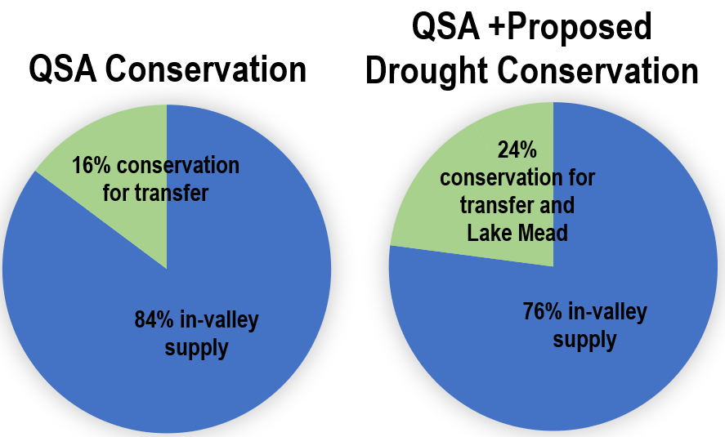
IID’s Additional Conservation Proposal Up to 1 million acre-feet of voluntary, compensated conservation through 2026
An additional 250,000 AFY of conservation will increase IID’s annual conservation target to 750,000 AFY, a more than 50 percent increase from 2022.
IID’s conservation was pre-conditioned, in part, on a state/federal commitment to address mitigation and funding of Salton Sea impacts related to accelerated playa exposure, permitting, IID Board of Directors approval and sufficient grower/landowner voluntary participation.
IID is actively engaged in IRA “1b” funding discussions with Reclamation.
IID’s focus will be to expand its existing system and on-farm efficiency conservation programs. IID is working to:
streamline its existing on-farm conservation program
develop a deficit irrigation/short-term summer fallowing program
revisit its prior rotational fallowing and socio-economics mitigation program (as a backstop)
Notes:
Finally, no one is more cognizant or concerned about the dire hydrologic conditions the Colorado River system is facing than IID. We have no other water supply, and if the reservoir elevations drop below deadpool, our community will cease to exist. This is not an exaggeration.
With California’s voluntary 400,000 AF drought protection proposal, IID has committed to increase its conservation goals by 50%, or another 250,000 AFY through 2026, to an astounding 750,000 AFY. This will be nearly a quarter of IID’s supply and is not an easy lift. While IID will prioritize additional investments in its efficiency-based conservation programs – this will almost certainly require some level of short-term fallowing, which can have ripple effects on our community.
This level of conservation comes at a cost, both locally and economically. IID is extremely appreciative of the $250 million in federal IRA funding Commissioner Touton has already secured for the California Natural Resource Agency’s Salton Sea Management Program. IID is also actively engaged with Reclamation regarding the funding necessary for it to achieve this extraordinary level of voluntary conservation.

